Slide 1

Module 14: Separating Web Servers
0/5
Analytics: Advanced Server Architect

Slide 2
Module Objectives
After completing this module you will be able to:
  Install the Siebel Analytics Web Server and Siebel Web Server on separate machines
Why you need to know:
  Performance or security requirements may mandate that the Siebel Analytics Web Server and Siebel Web Server be installed on different machines

Slide 3
Business Challenges and Solution
Integrated Siebel Analytics and Siebel Customer Relationship Management (CRM) installations may face additional business challenges, such as:
  Performance requirements may mandate that the Siebel Analytics Web Server (SAWS) and Siebel Web Server (SWSE) be on different machines
  IT security requirements may mandate that the SAWS and SWSE be on different machines
Solution: Install SAWS and SWSE on different machines
  The order of the installation is not important, but both must be installed and configured before the applications will communicate

Slide 4
Steps to Separate Web Servers
0/4
1. Create a Virtual IP Address
2. Configure Siebel CRM
3. Reconfigure Action Links
4. Test the Environment

Slide 5
1. Create a Virtual IP Address
1/4
Create one IP address shared by both servers
  Data is routed to physical machines by port number
Methods of creating a virtual IP address:
  Use third-party load-balancing software to create a virtual domain
    For example, siebel.abccompany.com
    Load-balancing software maps requests to appropriate machines using port number
  Use a hardware router to create a virtual IP address
    Router exposes one IP address externally
    Router routes requests to appropriate machines using port number

Slide 6
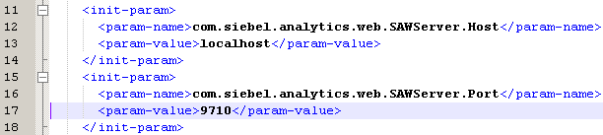
1. Configure Web Server Port Numbers
1/4
Configure Siebel Analytics Web to use a different port number
To configure the Siebel Analytics Web Server port number:
  Edit <SiebelAnalytics>/Web/App/WEB-INF/web.xml to specify a port number
  Call jar -cf Analytics.war -C Web from the command line to regenerate the Web archive (WAR) file
  Use HTTP Web server-specific tools to deploy the WAR file
Change the port number for the SAWS by editing web.xml and redeploying the WAR file

Slide 7
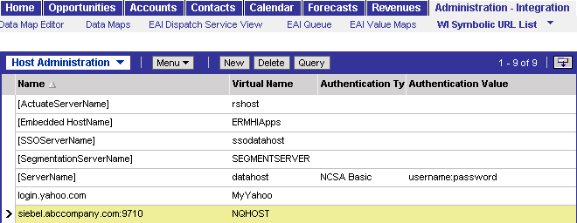
2. Configure Siebel CRM
2/4
Edit Siebel CRM’s NQHost parameters for Siebel Analytics Symbolic URLs to point to the virtual domain or IP address and port number, rather than the physical machine
Specify virtual host and port number as the symbolic host

Slide 8
3. Reconfigure Action Links
3/4
Action links must use the virtual IP address shared by the Web Servers
  Browser must support virtual IP addresses
For example:
  Siebel Web client using Internet Explorer can still use action links because the connection uses the virtual IP address
  Dedicated Siebel Web client no longer supports action links because the connection does not use the virtual IP address

Slide 9
3. Reconfigure Action Links Continued
3/4
Action links may refer to views in the Siebel CRM application
View names may contain illegal characters such as single quotes
  For example, Manager’s Account List View
Escape single quotes in the action link using the double backslash
  For example, <a href=\”javascript::NQSWENav(‘Manager\\’s Account List View’, ‘Account List Applet’, ‘”@”’);\”>”@” </a>

Slide 10
4. Test the Environment
4/4
Enter an address of <virtual domain>:<port>/analytics to test the Siebel Analytics logon
Enter an address of <virtual domain>/<Siebel application> to test the Siebel CRM logon
Navigate within the Siebel CRM application and verify that Siebel Analytics screens appear
Navigate within the Siebel CRM application and test charts and action links

Slide 11
Summary
This module showed you how to:
  Install the Siebel Analytics Web Server and Siebel Web Server on separate machines

Slide 12
Lab
In the lab you will:
  Answer questions about separating the Siebel Analytics Web and Siebel Web Servers

